Slide 1
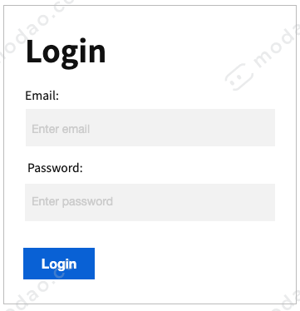
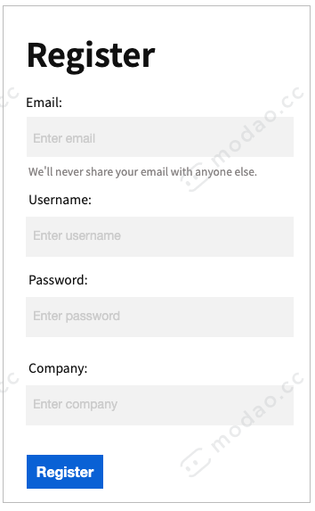
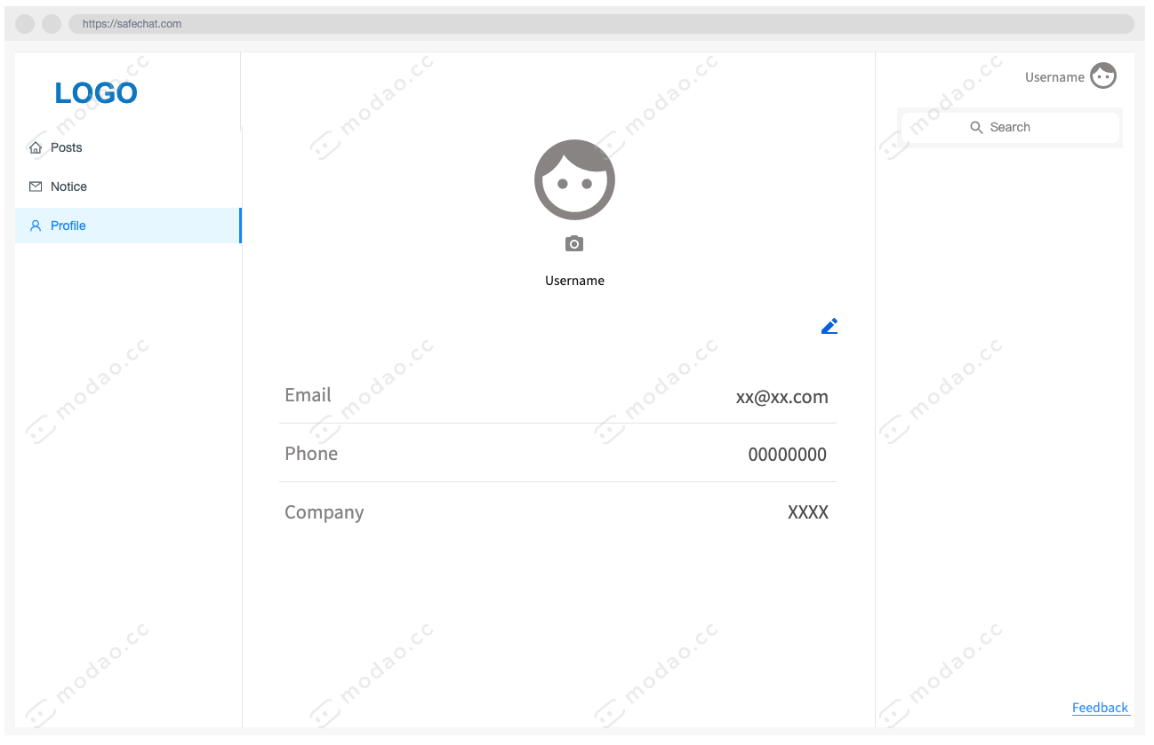
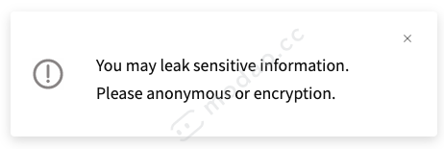
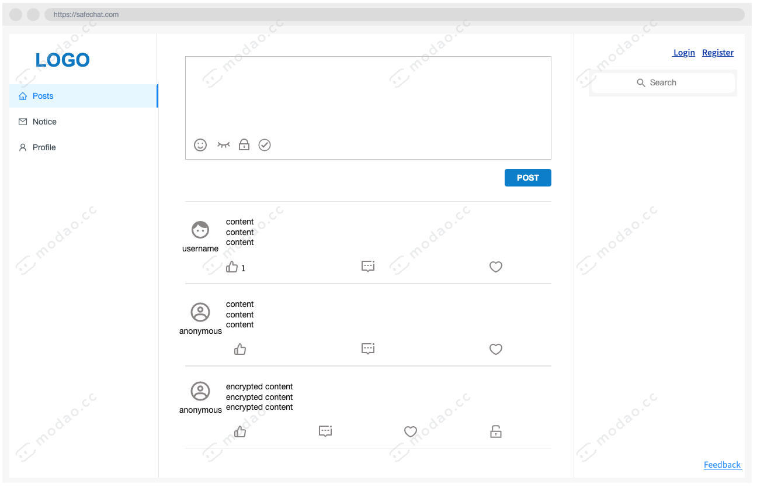
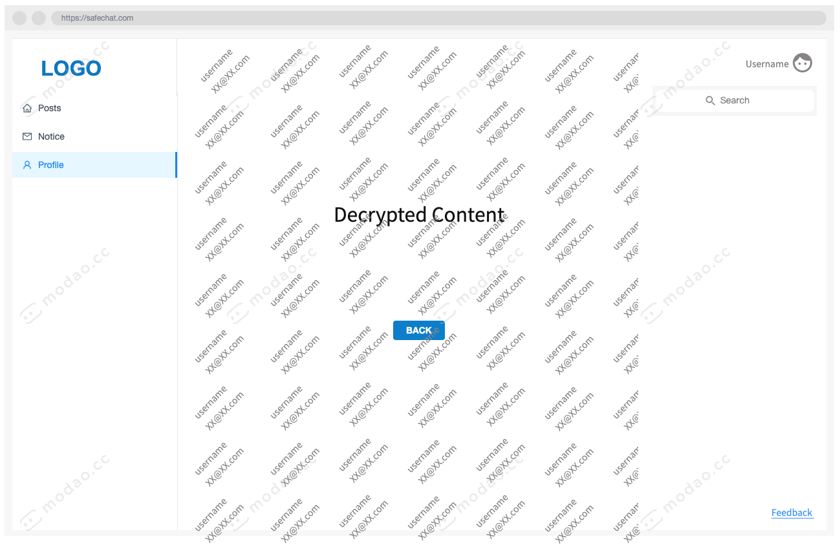
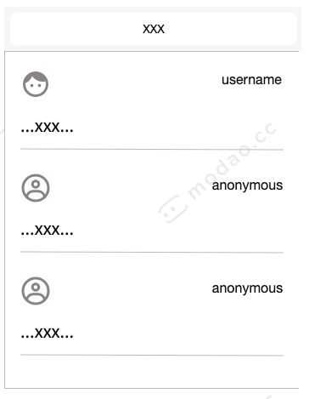

Slide 2
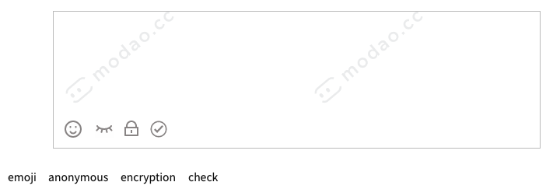

Slide 3
Salt (128 bits 22 chars)
$2b$10$JauHHZt/nhGon9jBTHbBr.VttY7GQqCskzJU3BDG4GUJO13UCNkG6
Bcrypt
Rounds(4-31)
Increasing by +1 doubles time to hash
Hash (138 bits 31 chars)

